Slide 1

RUNTIME TERRORS

Slide 2
TABLE OF CONTENTS
1
6
Problem Statement
Objectives Achieved
2
7
Target Audience
Prototype Implementation
8
3
Real-World Impact
Purpose of Project
9
Business Potential
4
Features of Project
5
The Technologies Included

Slide 3


PROBLEM STATEMENT
Design algorithms and frameworks that allocate patients to hospitals based on factors such as severity of symptoms, hospital occupancy, and available medical equipment which will provide government officials with insights for effective policy-making and resource allocation.

Slide 4

TARGET AUDIENCE
Our target audience are :
Hospitals
Patients
Goverment Officials

Slide 5

PURPOSE OF PROJECT
The main purpose of choosing this problem statement is that we saw a great trouble for patients to wander here and there for vacancy of beds in the hospital and goverment officials struggling to assign where to supply more medication. So we came up with a solution which can solve these problems to an extent.

Slide 6

FEATURES OF PROJECT
The features of the project are:
Easy detection of hospitals and available beds in accordance to given factors.
Formulation of government policies for future events.
Easy allocation of stocks to various hospitals on basis of our analysis.

Slide 7

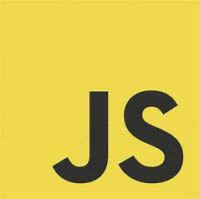

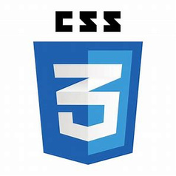
THE TECHNOLOGIES INCLUDED
The applications and languages that we have use are:
Python
HTML
CSS
JAVA SCRIPT(JS)

Slide 8

OBJECTIVES ACHIEVED
The objective that we were able to achieve so far are:
We were able to suggest and provide patient data of all the hospitals and details regarding bed availability as well.
From the analysed data, goverment will get some leads to form future policies and laws.

Slide 9

PROTOTYPE IMPLEMENTATION
Our prototype has two phases:
The front end deals with data collection having fields like patient number, temperature,pincode,test results and many more.
The back end will receive data from the front end and accordingly all the processing will start on the python files with visual representations of data will aslo be showcased.

Slide 10
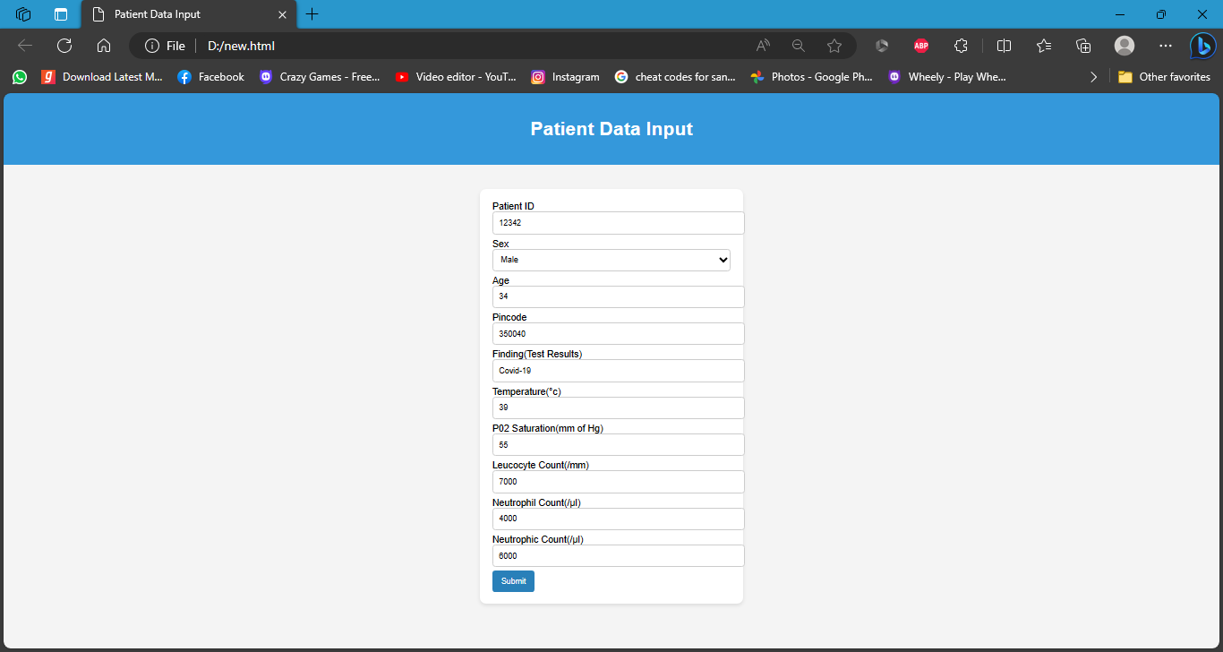
PROTOTYPE IMPLEMENTATION
FRONT-END
FRONT-END

Slide 11
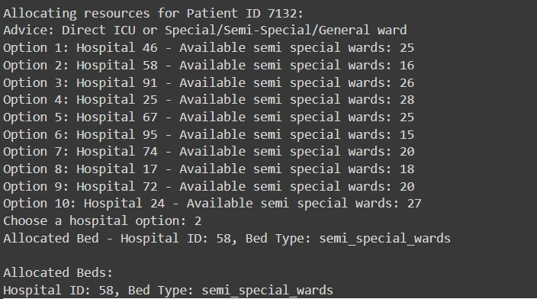
PROTOTYPE IMPLEMENTATION

Slide 12
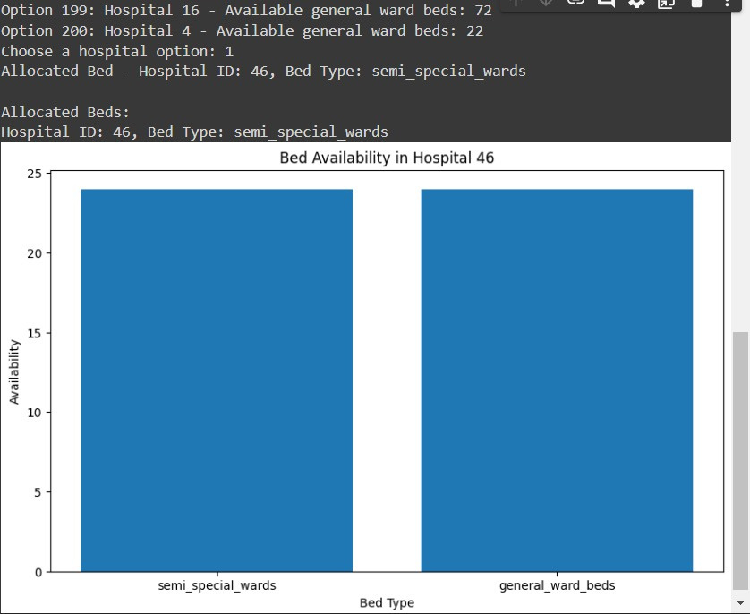
PROTOTYPE IMPLEMENTATION
GRAPHS
GRAPHS

Slide 13
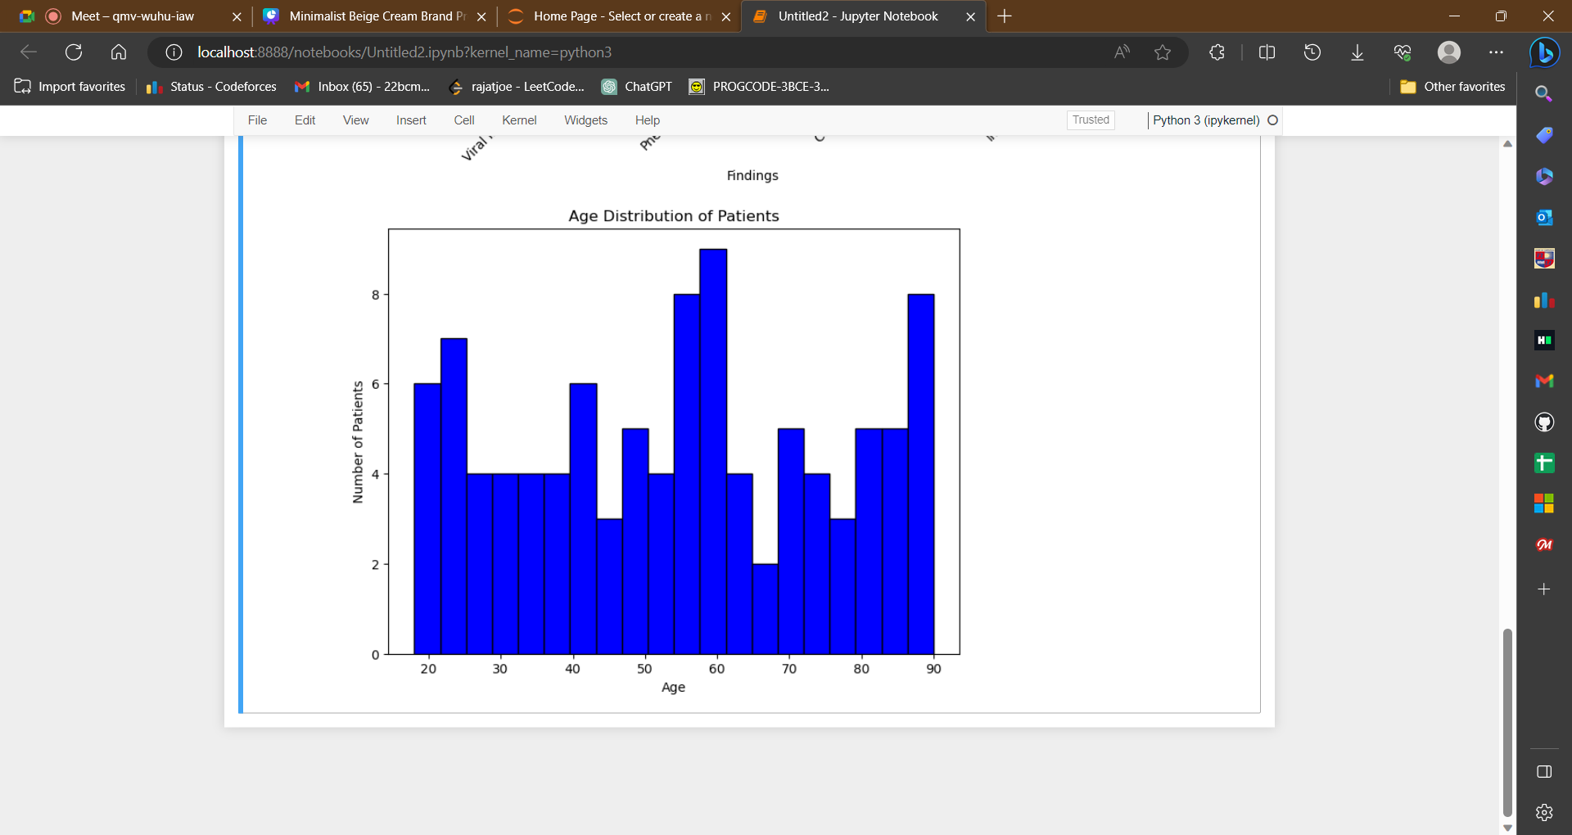
PROTOTYPE IMPLEMENTATION
GRAPHS
GRAPHS

Slide 14
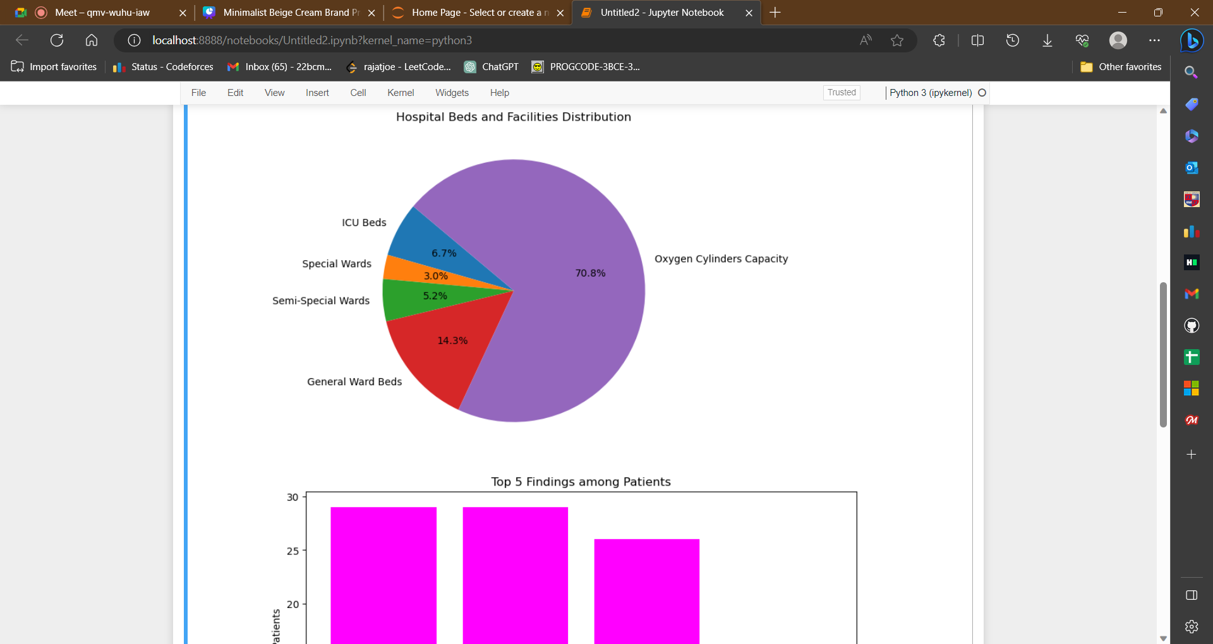
PROTOTYPE IMPLEMENTATION

Slide 15
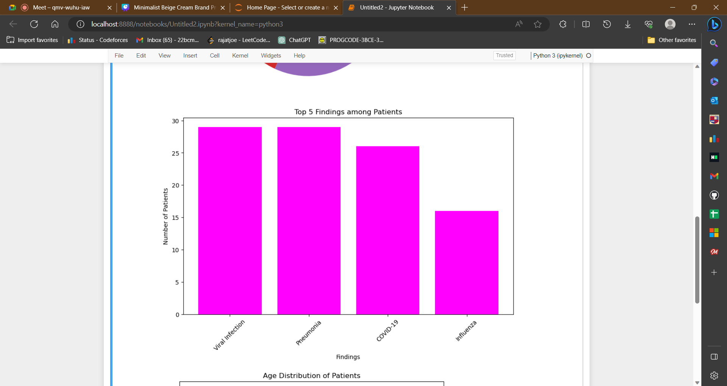
PROTOTYPE IMPLEMENTATION
GRAPHS
GRAPHS

Slide 16

REAL-WORLD IMPACT
The real world impacts that it will leave are as follows:
In future if any one has to find beds or vacant hospitals to admit then they can easily get the suggestion.
Goverment will have to take less time for decision making as well as for distribution of the supplies.

Slide 17

BUSINESS POTENTIAL
The business potential that we vision is:
As an app we can expand out business to other facilities like
Healthcare Workforce Management
Laboratory Testing Optimization
Medicine Stock Management
Goverment can allow us to expand for not only goverment hospitals but also create venture in other health care sectors

Slide 18


Slide 19
TEAM MEMBERS
Rushi Shah (Leader) - Nirma University
Rajat Goswami - Nirma University
Kartikay Saxena - Nirma University
Mohit Ginglani - Nirma University

